Slide 1





OPERATOR PRECEDENCE PARSER
BY
V Venkata Sree Harsha (1NT18CS181) N Sai Charan Reddy (1NT18CS104) Poorna Vikas (1NT18CS113)

Slide 2

Operator-Precedence-Grammar
A grammar that is used to define mathematical operators is called an operator grammar or operator precedence grammar.
Such grammars have the restriction that no production has either an empty right-hand side (null productions) or two adjacent non-terminals in its right-hand side

Slide 3


Operator precedence parser
An operator precedence parser is a bottom-up parser that interprets an operator grammar.
This parser is only used for operator grammars. Ambiguous grammars are not allowed in any parser except operator precedence parser.

Slide 4
Precedence Relations
In operator-precedence parsing, we define three disjoint precedence relations between certain pairs of terminals
a<b ‘b' has higher precedence than ‘a’
a=b ‘b’ has same precedence as ‘a’
a>b ‘b’ has lower precedence than ‘a’

Slide 5
CONTD
The determination of correct precedence relations between terminals are based on the traditionals are based on the traditional notions of associativity and precedence of operators

Slide 6
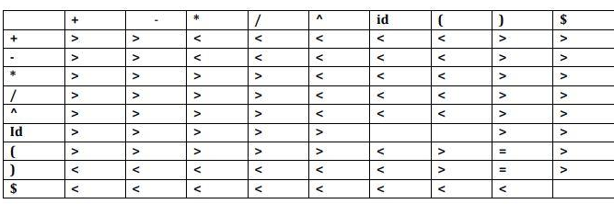
Using Operator-Precedence Relations
E -> e+e | e*e | e | e/e | e^e | (e) | -e | id | e-e
The partial operator-precedence table for this grammar
Then the i/p string (id+id*id) with the precedence relations inserted will be
$<id> + <id> * <id>$

Slide 7
Operator-Precedence Parsing Algorithm
The input string is w$, the initial stack is $ and a table holds precedence relations between certain terminals
Set p to point to the first symbol of w$:
Repeat forever
If ($ is on top of the stack and p points to $) then return
Else {
Let a be the topmost terminal symbol on the stack and let b be the symbol pointed to by p;
If (a<b or a=b ) then { /*SHIFT *?
Push b onto the stack
Advance p to the next input symbol;
}
Else if (a<b) then /*REDUCE*/
repeat pop stack
Until (the pop of stack terminal is related by < to the terminal most recently popped);
Else error();
}

Slide 8
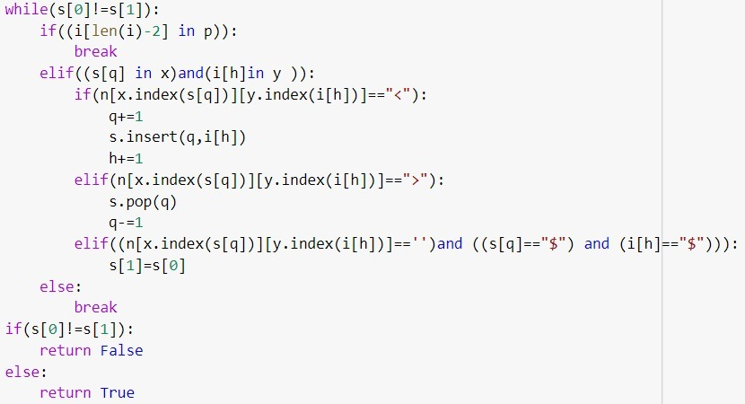
CODE SNIPPET

Slide 9
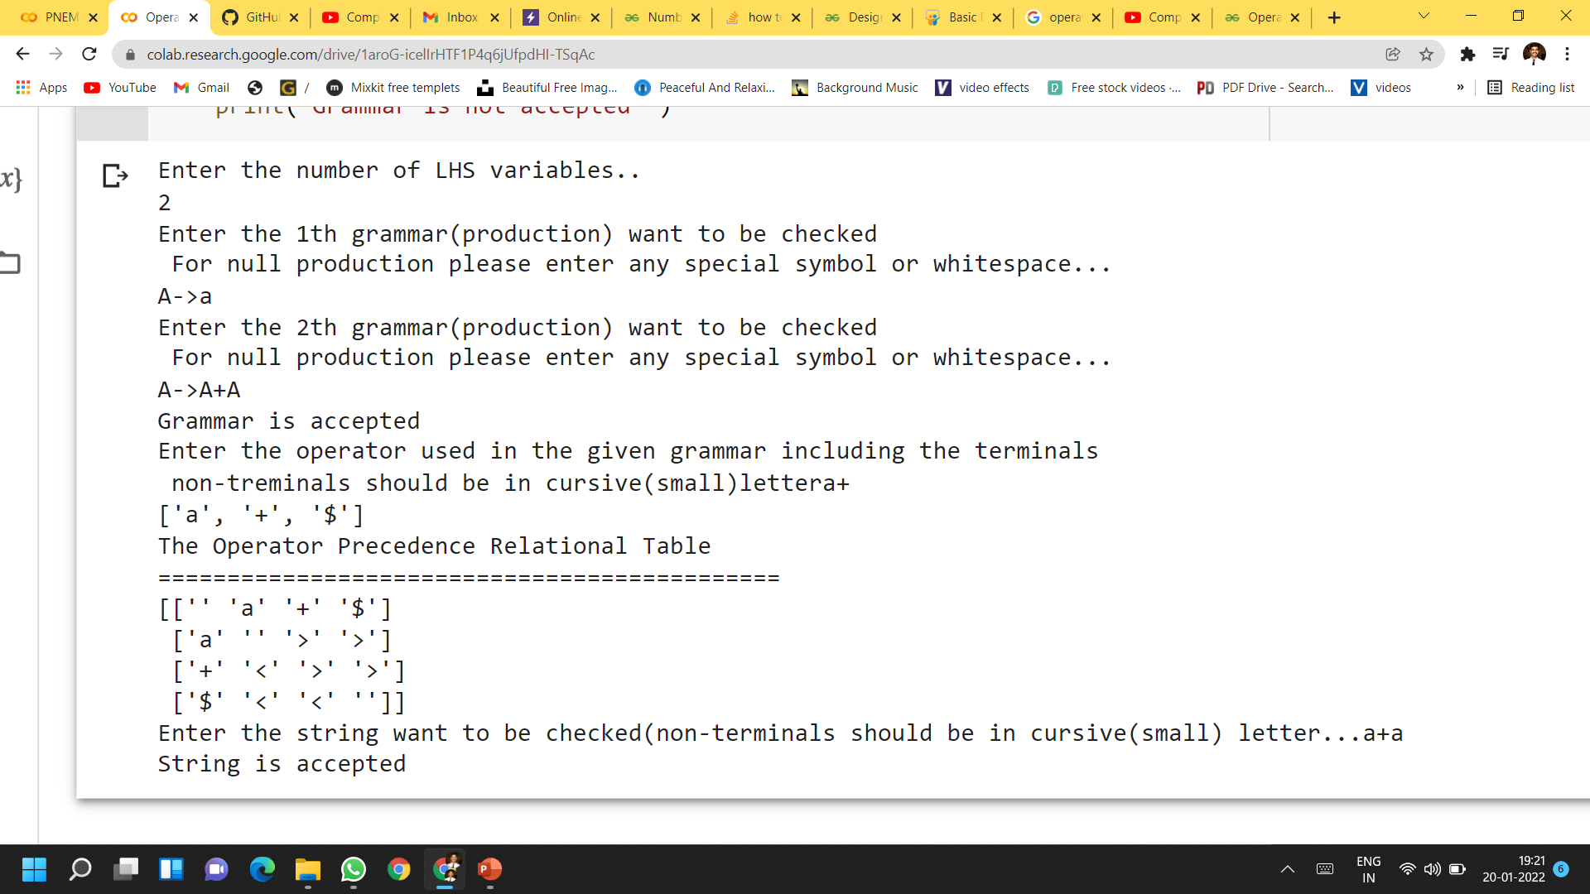
OUTPUT

Slide 10
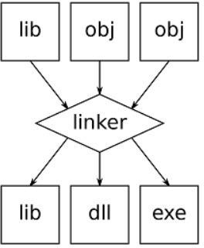

A linker is a specific application that merges the object files produced by the compiler/assembler and other bits of code to produce an executable file with the.exe extension.
The linker seeks and appends the libraries required for file execution to the object file.
It manages the memory region where each module's code will be stored.
LINKERS

Slide 11
TYPES OF LINKERS
1. Linkage Editor : Static Linking performs two major tasks:
Symbol resolution: Each Symbol has a predefined task and it associates each symbol with one symbol definition from which they belong.
Relocation: Modify symbol references to the relocated memory location and relocate code and data section.
2. Dynamic Linker: Performed at runtime. Multiple programs can share a single copy of the library. Each module having the same object can share information of an object with other modules rather than linking the same object to the library multiple times.

Slide 12


LOADERS
The loader is a special programme that receives object code from the linker, loads it into main memory, and prepares it for execution by the computer.
The Loader allots memory space to the application.
Even so, it establishes a symbolic link between items.
It is responsible for loading applications and libraries into the operating system.

Slide 13
TYPES OF LOADERS
1. Absolute Loaders: In this process the executable code is loaded into the same memory location of the program.
2. Relocating Loaders: it will produce the relative address but not the actual main memory address.
3. Dynamic run-time Loaders: In this method the actual address of the executable machine code is generated when an instruction is executed
Source code -> compiler -> Assembler -> Object code -> Linker -> Executable file -> Loader

Slide 14

Thanks!

